Slide 1
I C Engines – Part 3
Ramu Rajendran

Slide 2
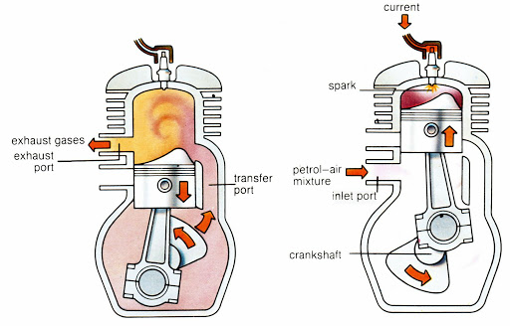
2 – Stroke Petrol Engine

Slide 3
Working
When Piston moves up
1) Inlet port opens – Air-fuel mixture gets filled in the crank case and below the piston. 2) Transfer port closes and exhaust port closes – Air-fuel mixture gets compressed as the piston moves further up to TDC.

Slide 4
Sparking and burning occurs - Piston moves down. Then
1) Exhaust port opens – Burned exhaust gas starts moving out. 2) Transfer port opens – Fresh air-fuel mixture comes into combustion chamber (also pushes out exhaust gases – SCAVENGING) 3) As piston moves further down to BDC it pushes more air-fuel mixture to the combustion chamber.

Slide 5
2-Stroke Petrol Engine

Slide 6
2 – Stroke diesel Engine
Same working
Differences are
1) Air comes in instead of air-fuel mixture 2) Fuel injector is used instead of spark plug 3) High compression ratio 4) Thermodynamic cycle is Diesel Cycle

Slide 7
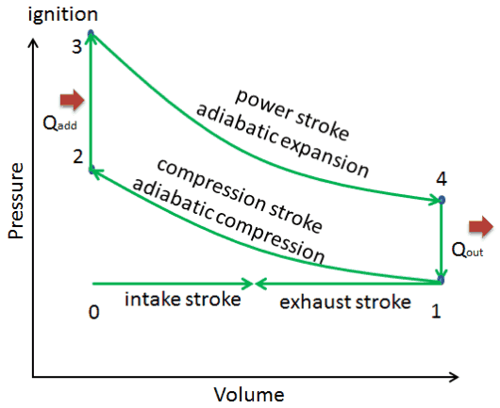
OTTO CYCLE

Slide 8
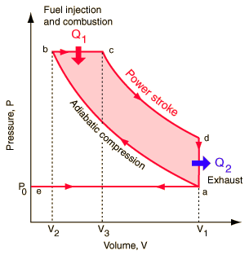
DIESEL CYCLE

Slide 9
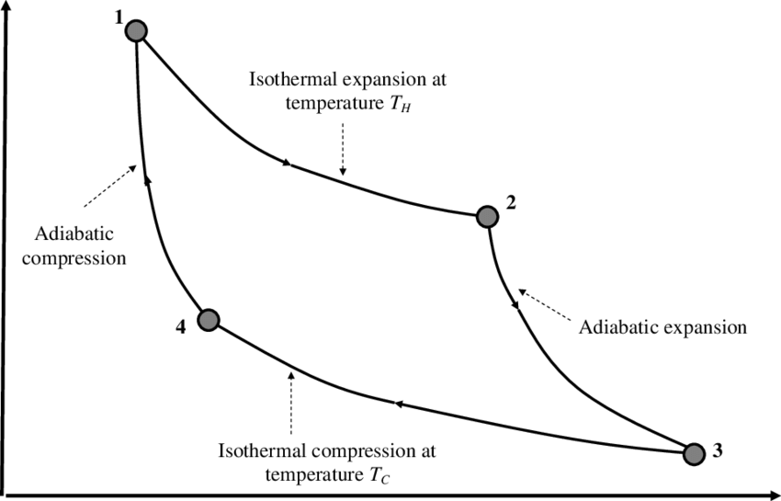
CARNOT CYCLE

Slide 10
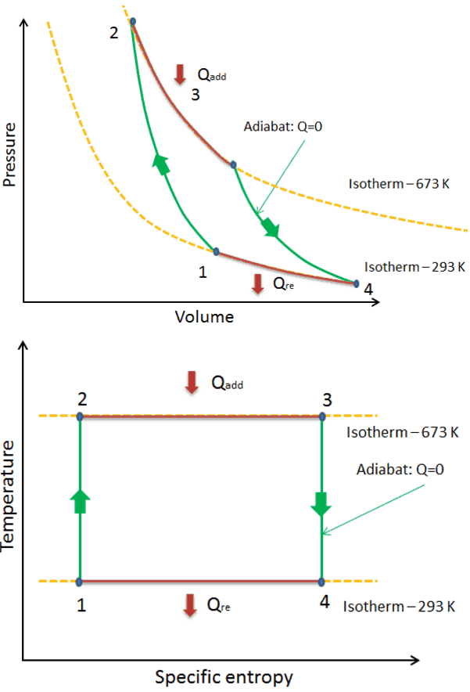
CARNOT CYCLE

Slide 11
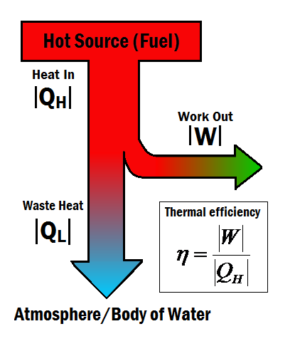
Efficiency
A measure of how good a system is.
Ratio of Output to Input. (Usually represented as percentage)

Slide 12
Efficiency
Efficiency = Work Produced/Heat Added
Work Produced = Heat Added – Heat Rejected
(Heat Added = Work Output + Heat Output)
Efficiency = (Qin – Qout)/Qin.

Slide 13
THANK YOU

